Slide 1
Low Power Use Case
POR, init, use RTC to WU every 1 sec, toggle GPIO and go back to sleep.
Using BLPI Core at 4 MHz Flash 800 KHz

Slide 2
Main – toggles IO, COP , ACKISO & enters Low power
int main(void)
{ for(;;) {
counter++;
SIM_SRVCOP = 0x55; // 1st write to service COP
if (counter & 0x0001) F_LED0_ON;
else F_LED0_OFF;
if (counter & 0x0002) F_LED3_ON;
else F_LED3_OFF;
if (counter & 0x0004) F_LED2_ON;
else F_LED2_OFF;
if (counter & 0x0008) F_LED1_ON;
else F_LED1_OFF;
SIM_SRVCOP = 0xaa; //2nd Write to service COP
PMC_REGSC |= PMC_REGSC_ACKISO_MASK; //write to release hold on I/O
//enter_vlps(); or enter_lls(); or
//enter_vlls1();
} return 0;
}

Slide 3
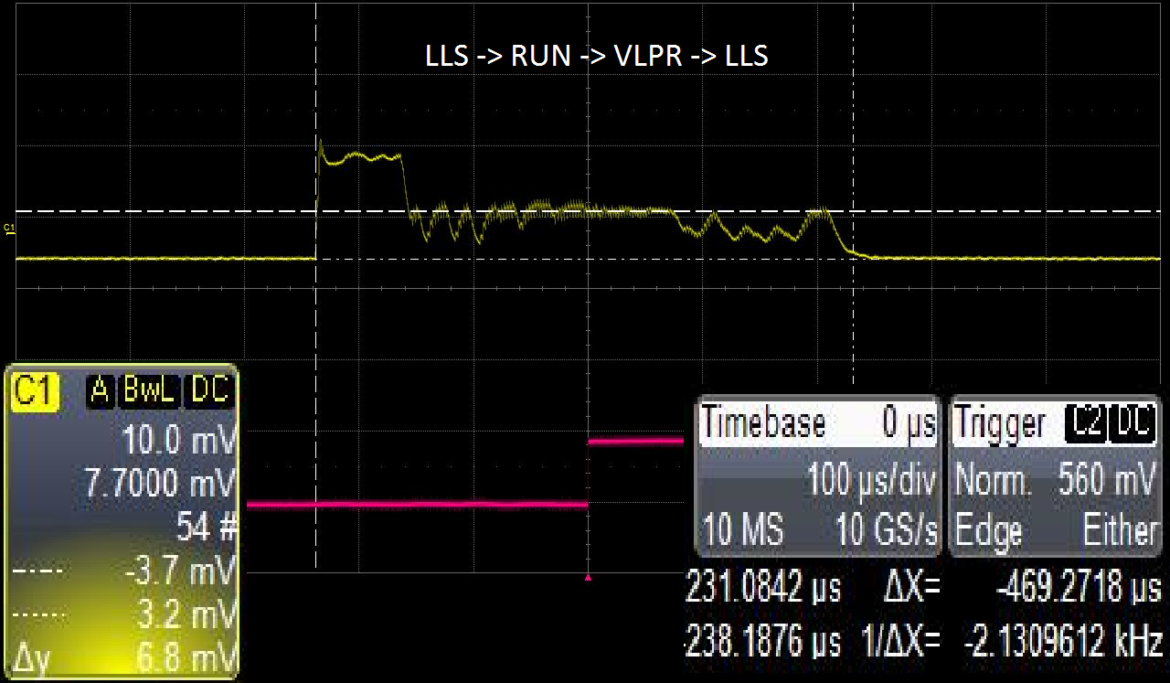
Wakeup from LLS to RUN(BLPI 4MHz) to VLPR back to LLS

Slide 4
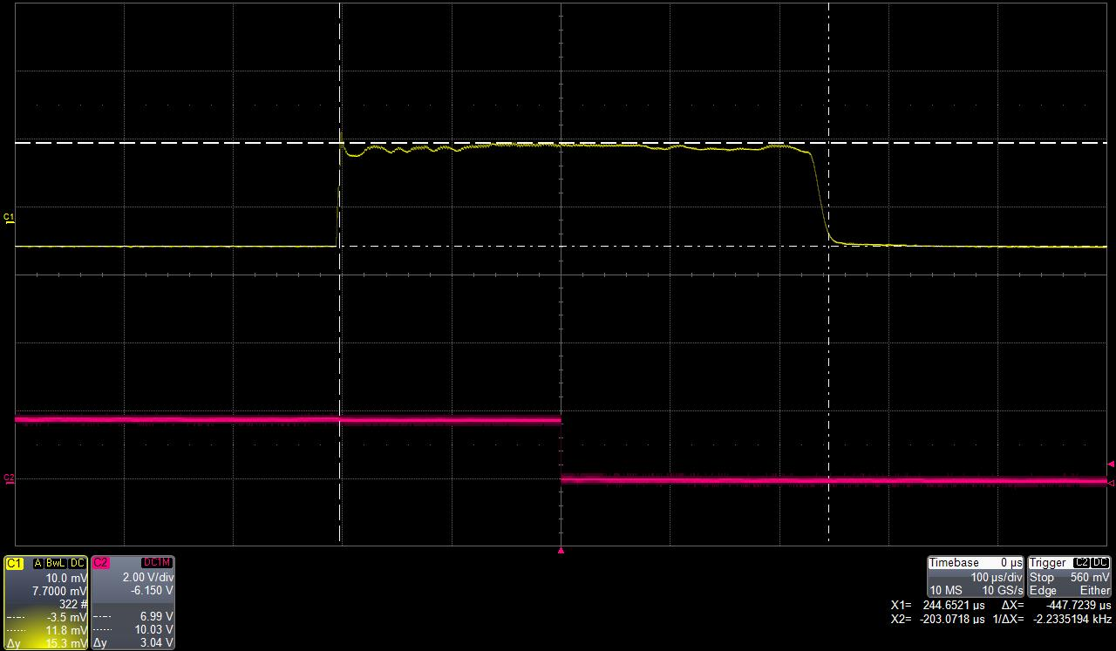
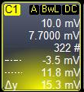

Wakeup from LLS to RUN (BLPI 4MHz) back to LLS

Slide 5
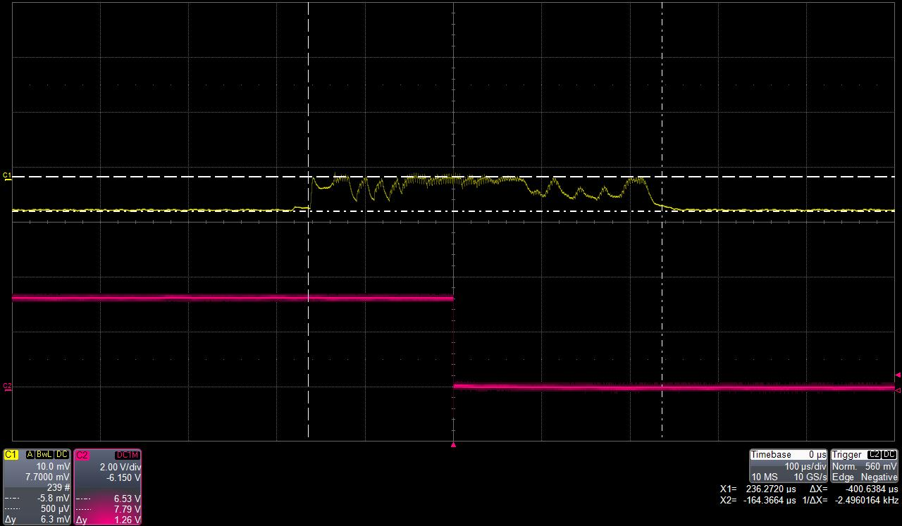
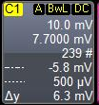

Wakeup from VLPS to VLPR(BLPI 4MHz) back to VLPS

